Slide 1
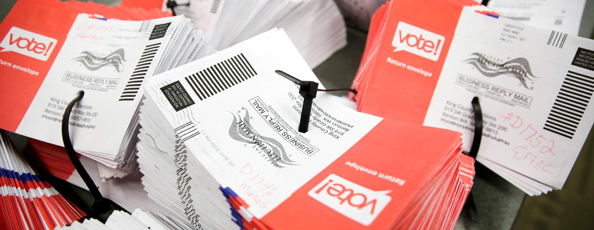
Political Polling 101

Slide 2
A Bit About Me
I work as a pollster and strategist for Democratic candidates and committees as well as progressive issue advocacy groups – with a focus on climate and the environment.
  Partner at Global Strategy Group – Largest Dem Polling Firm in the Country
  Pollster for over 15 years
  Before that, worked on campaigns and was a wannabe scientist
  Undergrad and grad degrees in Physics/Engineering
Examples of clients
  Jacky Rosen (NV-Sen, 2018 and 2024)
  Kristen McDonald Rivet (MI-8 2024), Gabe Vasquez (22/24), Jason Crow CO-6, 18-24)
  Senate Majority PAC (In support for Cortez Masto in ‘16, Hickenlooper in ‘20, Kelly in ‘22)
  Michigan Proposal Two: Voting Rights Ballot Measure (2022)
  League of Conservation Voters and Environmental Defense Fund
Notes:
Presentation notes: I should note at the top that I’m a Democratic partisan who thinks that only Buchanan and Andrew Johnson rival Trump in for the title of worst president in U.S. history – so that’s the perspective I bring to this entire discussion…

Slide 3
What it Takes to be a Good Political Pollster
Yes, having some quantitative background helps, but it’s not the most important thing or even an absolute requirement. There are bad pollsters who came from strong quant backgrounds and good pollsters who have none (and vice versa).
The most important skills are actually on the softer side:
  Knowing how to write a survey that gives your client the information they need to formulate the right strategy.
  Knowing how to read and interpret the data in the way that tells the story of the campaign and leads to direct and actionable recommendations.
In political polling, measuring the current state if the race is only about 10% of what we do. The more important 90% is figuring out how we get from there to a win on Election Day.
Notes:
Presenter notes:
Me and Drew Lieberman
I got into polling because I had the numbers background, and that’s helped for sure, but the things that have made me successful are mostly things I learned on the job.
Example of how I used to hate public speaking, now I give talks to rooms of hundreds, to Senators, or go on TV and I love it.

Slide 4

Strategic Research in Political Elections
Strategic research provides the basis of an informed plan for all aspects of a campaign.
Most important use: developing message and targets:
  Who do we need to communicate with
  What do we need to say to them
  How do we allocate our resources most efficiently

Slide 5
Goals of Strategic Electoral Polling
Political polling provides answers to key questions such as:
  Who is currently winning the election?
  When we simulated a campaign, who wins the election?
  What issues are most important to voters?
  How do voters view the candidates?
  How should we introduce the candidate to voters?
  What are our candidate’s biggest vulnerabilities?
  How should we attack our opponents?
  How should we communicate our issue stances to voters?
  Who is in our key target universe?
  Where should we allocate our resources?

Slide 6
The Various Tools in our Toolbox
Quantitative Research
  Benchmark surveys: determining the roadmap of a campaign
  Tracking and brushfire surveys: providing course corrections
  Modeling and microtargeting: targeting at the individual level
  Ad testing: understanding which ad(s) move which voters the most
Qualitative Research
  The purpose: to get a textured understanding of the attitudes and value that will drive voters’ decisions
  Focus groups: Real-time, in-person or online discussions with 6-8 people at a time
  Qual boards: Online discussion boards where 20-25 voters interact with each other and a moderator over three to five days.

Slide 7
Quantitative Methodology
Methodologies
  Phone interviews (landline and cell) using sample pulled from the voter file
  Text-to-web interviews using sample pulled from the voter file
  Online interviews using various panel vendors
    Probability vs. non-probability
    Matched to the file, pseudo-matched, or unmatched
  These days, we are usually using a combinations of two or more of these
Sampling frames
  Likely voters vs. Registered voters vs. Something else
  How we determine who is a likely voter
    Using vote history vs. PPS sampling using turnout scores

Slide 8
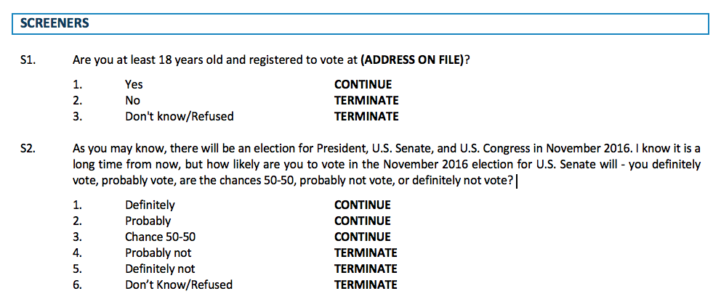
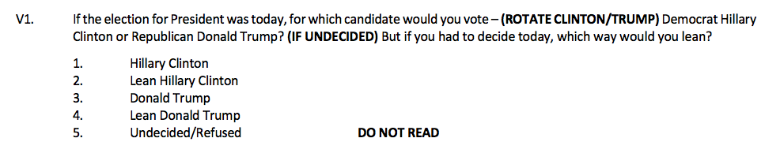
Typical Political Benchmark Survey Structure
SCREENERS
CANDIDATE PROFILES
Intro to candidates
INFORMED VOTE
MESSAGE TESTING
Positive/Negative Message Battery → Ordering of messaging is meant to simulate the likely communications environment of the race
POLITICAL ENVIRONMENT
Right direction/Wrong track
Favorability Battery
Most Important Issue Battery
INITIAL VOTE
FINAL VOTE
DEMOGRAPHICS
Notes:
8

Slide 9
Typical Deliverable Includes:
In-depth analysis of the state of the race as it is now
  The political environment, strength of the candidates, where the vote stands among key demographic groups
Simulation of how the race moves under messaging
  One we engage, how does the race move. Is positive or negative message most effective. Which groups move and which don’t.
Recommendations on message
  What are the combinations of profile and message that we believe will resonate the strongest with the most important targets.
  Not just which messages score best, but how do all of the data fit together to tell the strongest over-arching story.
Targeting recommendations
  Who are the most important voters to talk to

Slide 10
Discussion Example: Jason Crow in 2018 (CO-6)

Slide 11
Discussion Example: Jason Crow in 2018 (CO-6)
The challenge: “Invincible” Mike Coffman won in 2016 by 8 even as Hillary won his district by 9
Early focus groups to understand the mood of the electorate, and how to unlock Clinton-Coffman voter - Told us many of our assumptions were wrong and that Jason was our bet messenger
Two benchmark surveys to develop the overall roadmap:
  Showed that if we communicated the right way, we should win relative easily
  Jason’s bio and positive message resonated very strongly with white swing voters
  But we needed hard negative on Coffman to dislodge voters of color who usually vote Dem but saw Coffman as a different kind of Republican (he wasn’t)
  Needed our allies to relentlessly tie Coffman to Trump using 95% voting record – most in CO
Several tracking surveys to assess progress and provide course adjustments
  Went from -2 to +8. Ended up winning by 11

Slide 12
Initial Ballot: Crow down 2 and under-performing the generic ballot more among voters of color and outside of Arapahoe County
Initial Vote – Two Way Ballot
Crow | Undecided | Coffman
Net Crow Crow - Coffman -2
Net Generic Dem - GOP +10
Swing % Favorable
X
X
X
X
X
X
X
X
X
X
X
X
X
X
Month Fav. | Unfav.
xx | | | Xx
xx | | | Xx
xx | | | Xx
xx | | | Xx
xx | | | Xx
xx | | | Xx
xx | | | Xx
xx | | | Xx
xx | | | Xx
Xx | | | xx
Xx | | | Xx
Xx | | | Xx
Xx | | | Xx
Xx | | | Xx
Month | Month
% Favorable
X | X
X | X
X | X
X | X
X | X
X | X
X | X
X | X
X | X
X | X
X | X
X | X
X | X
X | X
% very fav | % very unfav
% very fav | % very unfav
% very fav | % very unfav
% very fav | % very unfav
% very fav | % very unfav
% very fav | % very unfav
% very fav | % very unfav
% very fav | % very unfav
% very fav | % very unfav
% very fav | % very unfav
% very fav | % very unfav
% very fav | % very unfav
% very fav | % very unfav
% very fav | % very unfav
-1
+37
+6
+49
-17
+11
-10
+19
+9
-14
+17
-8
-5
+3
+1
+9
+8
+12
-17
+15
+15
-4

Slide 13
Balanced profiles moved Crow to double-digit lead, which expands with further messaging
Vote Movement
Crow
Coffman
Undecided

Slide 14
Crow’s profile moves Unaffiliated voters and GOP women, issues move Dems more. But no gains with voters of color
Vote Movement – Key Gains
Demographic |  | Initial Net | Informed Net | Change from Initial to Informed | Final Net | Change from Informed to Final | Change from Initial to Final
Total |  | +2 | +11 | +9 | +15 | +4 | +13
Democrats |  | +73 | +74 | +1 | +82 | +8 | +9
Unaffiliated |  | +14 | +30 | +16 | +34 | +4 | +20
Republicans |  | -78 | -68 | +10 | -67 | +1 | +11
White |  | -2 | +8 | +10 | +12 | +4 | +14
Voters of Color |  | +37 | +33 | -4 | +36 | +3 | -1
White Men |  | -17 | -8 | +9 | -2 | +6 | +15
White Women |  | +12 | +22 | +10 | +24 | +2 | +12
White Non-College |  | -5 | +8 | +13 | +13 | +5 | +18
White College |  | +2 | +11 | +9 | +13 | +2 | +11
Republican Women |  | -70 | -55 | +15 | -56 | -1 | +14

Slide 15
Both profiles strong but PACs frame resonates most strongly with swing voters and gives Crow a larger lead on the informed ballot
Initial Vote vs. Informed Vote
Split sample
Split sample
Read to all
Crow Profile – New Generation/PACs
Jason Crow grew up in a working-class home and worked construction jobs to pay his way through college. He led combat units during three tours in Iraq and Afghanistan, earning a Bronze Star, before working as a lawyer and veterans advocate in Colorado. As a first-time candidate, Jason believes Congress is broken and that both parties need a new generation of leaders who will put regular Americans' interests first and not take their orders from party leaders or special interests - which is why he's refusing to take any money from Corporate PACs.
Overall | Swing
% Very appealing
57 | 62
47 | 39
31 | 29
Crow Profile – New Generation/Trump/Pelosi
Jason Crow grew up in a working-class home. He led combat units during three tours in Iraq and Afghanistan, earning a Bronze Star, before working as a lawyer and veterans advocate in Colorado. As a first-time candidate, Jason believes Congress is broken and that both parties need a new generation of leaders who will put regular Americans' interests first and not take their orders from party leaders or special interests -which is why he will never be afraid to stand up to leaders of either party to do what is right - including Donald Trump and Nancy Pelosi.
Mike Coffman is a military veteran, former small business owner, and member of Congress who believes in common-sense, independent leadership. Coffman grew up in Aurora and is the only member of Congress to have served in both Iraq wars. In Congress, Coffman led the fight to reform the VA when they failed our wounded warriors. He has earned praise from the Denver Post for his willingness to stand up to his own party to put the country and the people he represents first – including voting against Donald Trump's healthcare repeal bill.
Crow | Undecided | Coffman
Net Crow
-2
+13
+8

Slide 16
Issue messages on health care and guns resonate most with voters, followed closely by Pelosi, taxes and higher ed
Top Positive Messages for Crow
Overall | Swing
% Very convincing
35 | 37 | Health Care Crow will fight against politicians who want to end protections for people with pre-existing conditions or allow insurance companies to charge older Americans more. Instead, he'll work with both parties to fix the health care system and take on insurance and drug companies to bring down the cost of premiums and prescription drugs.
35 | 39 | Guns As a veteran who used firearms on a daily basis and a father with two young children, Crow will stand up to the gun lobby to pass common sense gun safety laws -like background checks -that will make our families safer.
34 | 32 | New Generation/Pelosi Crow believes that both parties need a new generation of leaders who will put the people they represent first. That is why he will not support Nancy Pelosi to be Speaker of the House and will never be afraid to stand up to leaders of either party -including Donald Trump -to do what is right.
33 | 33 | Taxes/Priorities Crow will work to overturn Trump's tax law that gave trillions in breaks to wealthy corporations while saddling our children with debt. Instead, Crow will fight to use that money to cut taxes on middle class families, protect Social Security and Medicare, and to invest in our local schools and roads.
33 | 31 | Higher Education Crow understands the struggle that many families face with the high price of college because he and his wife relied on student loans to help get through college and graduate school. Crow will fight to make college more affordable and cut interest rates for those who already have student loan debt.

Slide 17
Initial Recommendations
Make sure we lay down Jason’s profile with a particular focus on white Unaffiliated voters and Republican women.
In addition to touting Jason’s working-class roots, military experience, and rejection of Corporate PAC money, this profile should emphasize the need for a new generation of leaders who will put regular Americans first.
And it should also, unsurprisingly, set up the contrast with Coffman over Trump.
When we move to issues on the positive side, we should focus on healthcare and guns.
This may change based on the contrasts we want to set up with Coffman coming out of the negative survey, but the health care message really stuck with voters in the open end.
We want to make sure that we, and our allies, do everything we can to tie Coffman to Trump – particularly with voter of color.

Slide 18
Recommended Language
Jason in 30 seconds
Jason Crow grew up in a working-class home and worked construction jobs to pay his way through college before leading combat units during three tours in Iraq and Afghanistan, earning a Bronze Star. Jason believes Washington is broken and that both parties need a new generation of service-oriented leaders who will hold Donald Trump accountable, put regular Americans first, and not take their orders from party leaders or special interests - which is why he's refusing to take any money from Corporate PACs.

Slide 19
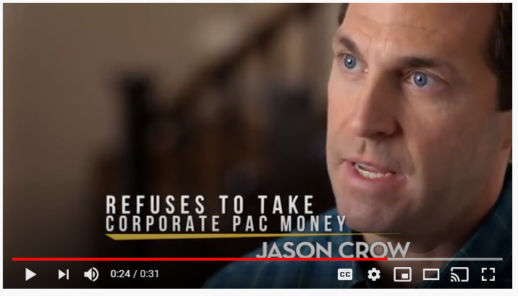
Where This All Leads: Our Intro Ad

Slide 20
Polling Accuracy 2016 to 2024

Slide 21
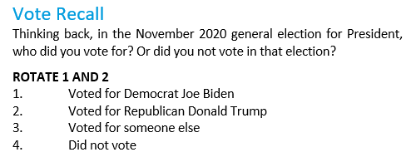
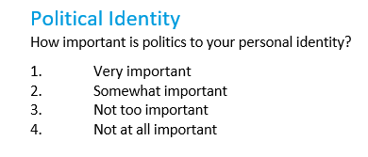
The industry has some misses in ‘16 and ‘20 but our work to correct for non-response bias paid off in very accurate polls in ’22 and ‘24
Election Day 2022
GSG’s polling was incredibly accurate. GSG had just 0.8% bias in our statewide polling and a nearly perfect 0.2% bias in our house polling.
Election Day 2020
Polls across the industry underestimated Trump and down ballot Republicans.
Late 2020 to 2021
GSG conducts a rigorous internal analysis of nearly 30,000 interviews to identify the cause of polling error; Study finds main cause of 2020 polling error to be non-response bias.
Late 2021 to 2022
GSG led months-long multi-method research study to explore ways to further reduce non-response bias. This identified a correlation between political engagement and non-response bias.
 |  | 2020 | 2022 | Diff
Statewide | Error | 3.1% | 2.3% | -0.8%
 | Bias | D+3.0% | D+0.8% | -2.2%
House | Error | 3.5% | 2.1% | -1.4%
 | Bias | D+3.3% | D+0.2% | -3.5%
June 2021
GSG implemented new internal practices including, weighting to presidential vote recall and new attitudinal variables.
Spring 2022
GSG adds additional standards controlling for political engagement.
Election Day 2024
GSG’s polling was incredibly accurate again. There was heated debate about this approach during the election, but our approach proved correct as GSG has just a 0.6% bias in our polling – significantly better than public polling
Notes:
ANDREW

