Slide 1
Political Polling - A crucial tool in understanding public opinion and shaping US democratic processes
How are polls developed?
How are polls used?
How do we need to think about
Poll results in our elections – candidates, policies?
March 19, 2025
5:30pm to 7:00pm PST
Panel discussion will be recorded and posted on AAUW WA Online Website: https://wa-online.aauw.net/

Slide 2
Agenda
AAUW WA Online Program Lead, Melissa Johnsen –
Introduces Kelvie Comer, Online Branch co-President
Introduces Facilitator, Carolyn Hayek (2 min)
Welcome by AAUW-WA Online Branch co-President, Kelvie Comer
AAUW Mission and Land Acknowledgement (3 minutes)
AAUW WA Online Carolyn Hayek, Facilitator - Our Program Objective (5 min)
Polling Basics – Set Some Context (1 min)
Program Speaker, Andrew Baumann – Introduction (2 min)
Presentation (20 min)
Q & A – Facilitated (20 min)
Audience Q & A (20 min)
AAUW WA Online Branch Program Lead - Call to Action - Dorothy McBride ( 5 minutes)
Closing and thank you by AAUW-WA Online Branch President (1 minute)
AAUW WA Online Website: https://wa-online.aauw.net/
Panel discussion will be recorded and posted on AAUW WA Online Website
Melissa Johnsen
Agenda: 1 min
2

Slide 3
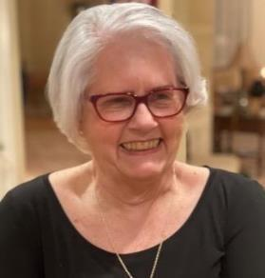
Welcome: AAUW Washington State Online President
Kelvie C. Comer, Ed.D.
AAUW-Washington State Online Branch President
Bio in Appendix
Agenda: 3 mins

Slide 4
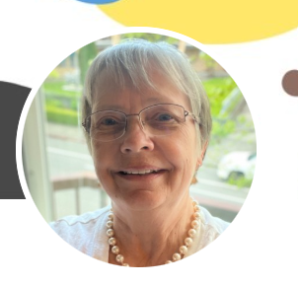
Carolyn Hayek– Facilitator
Carolyn Hayek
President Lake Washington Branch AAUW
AAUW-Washington State Online Branch
Bio - Appendix
Agenda: 1 mins
Melissa Johnsen
4

Slide 5
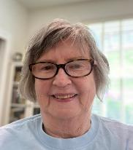
Dorothy McBride – Call to Action AAUW WA Online – Public Policy Committee, Member; WA State Public Policy Committee
Agenda: 1 mins
Dorothy McBride
BIO in our Appendix
Melissa Johnsen
5

Slide 6
AAUW Vision & Mission & Values
AAUW VISION
Equity for all.
AAUW MISSION
To advance gender equity for women and girls through research, education, and advocacy.
AAUW VALUES
Nonpartisan. Fact-based. Principled. Inclusive and Intersectional.
AAUW WA Online Web Site
https://wa-online.aauw.net/
Kelvie Comer

Slide 7
Land Acknowledgement
AAUW Washington State Online Branch wishes to acknowledge that our branch spans the ancestral lands and traditional waters of many indigenous peoples.
We honor their indigenous cultures, histories, identities, and current realities
Kelvie Comer
7

Slide 8
Panel Objectives: Understand Political Polling and how to think about polling as you make electoral decisions
INTRODUCTION
Carolyn Hayek
AAUW WA is a non-partisan organization, but we are policy aligned with parties and candidates.
AAUW WA has a strong policy agenda:
Economic Security for Women
Quality Public Education for all Students
Civil Rights—Gender, Racial and Social Justice
Health and Wellbeing
Our Objective is to learn about Polling and how it is a crucial tool in understanding public opinion and shaping our US democratic processes
How are polls developed?
How are polls used?
How should we think about Poll results in our elections – candidates and policies?
Carolyn Hayek
Agenda: 2 mins
AAUW WA Online Website: https://wa-online.aauw.net/

Slide 9
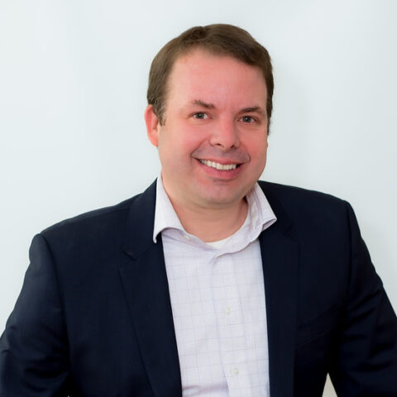
Who is Andrew Baumann?
Andrew Baumann, is a Partner, Research with Global Strategy Group.
GSG was founded in 1995, Global Strategy Group (GSG) began as a Democratic polling firm. Over two and a half decades, the firm has evolved into a full-service research, public affairs, and communications agency.
Named one of the “winners” of the 2022 elections in Colorado and praised by the media for his “remarkably accurate” polling, Andrew Baumann began his career as a physicist before deciding to give up supercolliders for Senate campaigns. Since becoming a strategist and pollster nearly two decades ago, he has provided research and strategic advice to political campaigns, issue advocacy organizations, unions, and foundations.
Over the past decade and a half, Andrew has helped elect or re-elect Senators John Hickenlooper, Michael Bennet, Jacky Rosen, Catherine Cortez Masto, Gary Peters, Debbie Stabenow, Tammy Baldwin, and Tom Udall.
In 2024 Andrew helped guide Democrats to victory in four of his five Frontline races: Senator Jacky Rosen (NV), Congressman Gabe Vasquez (NM-02), Congresswoman-elect Kristen McDonald Rivet, and Congresswoman Hilary Scholten (MI-03).
In addition to his political work, Andrew has also polled for numerous advocacy groups with a particular focus on climate, clean energy and conservation issues, having worked with LCV, Environmental Defense Fund, Climate Power, the Sierra Club, and many others. His work in 2020 was instrumental in helping convince Joe Biden to make climate a centerpiece of his campaign and embrace a more ambitious climate plan.
Andrew also served as pollster and strategist for the National Education Association for over a decade, working with NEA and its affiliates in Virginia, Colorado, and Michigan on a range of issues, but with a particular focus on helping the union understand how to recruit and retain more members.
With degrees in Physics and Engineering from MIT and Stanford, Andrew also has extensive experience working with data scientists to develop new methodologies and implement innovative analytical data solutions for clients.
Melissa Johnsen 2 min

Slide 10
Andrew Baumann Presentation
20 min
Please be on mute

Slide 11
Andrew Baumann & Carolyn Hayek: Q & A
Facilitated Q & A
Andrew Baumann & Carolyn Hayek
20 min

Slide 12
Audience Q & A
Attendee Q & A with Andrew Baumann
20 min
Provide questions in Chat or Raise your virtual ‘hand’ in Zoom
Carolyn Hayek & Melissa Johnsen will ensure questions are provided to Andrew

Slide 13
CALL TO ACTION: Political Polling
Learn
Advocate
Act
Dorothy McBride
Agenda: 5 mins
AAUW WA Online Website: https://wa-online.aauw.net/

Slide 14
Call to Action: Learn, Advocate & Action – Public Policy Advocacy
LEARN
Pew Research: Pewresearch.org
AP Monthly Polls: apnorc.org
Quinnipiac University Polls
https://poll.qu.edu/
Center for an Informed Public at the University of Washington www.cip.uw.edu
About the legislative process in Washington state https://leg.wa.gov/legislature/Pages/Overview.aspx
Join observer corps with local League of Women Voters and see how local government works. https://www.lwvwa.org/
Keep informed:
https://washingtonstatestandard.com/
https://aauw-wa.aauw.net/public-policy/
Sign up for This Week in Olympia
https://aauw-wa.aauw.net/public-policy/
14

Slide 15
Call to Action: Learn, Advocate & Action – Public Policy Advocacy
ADVOCATE USING TRUSTED PUBLIC OPINION DATA
HOW TO TELL IF POLL IS RELIABLE ?
DO THEY OFFER THE FOLLOWING INFORMATION?
MARGIN OF ERROR?
FUNDERS?
SAMPLING METHODS ?
QUESTIONS ARE NEUTRALLY WORDED?
CHOICE OF ANSWERS IS CLEAR?
Attend AAUW-WA Public Policy Committee meetings. Contact Public Policy chair: publicpolicy@aauw-wa.org
Volunteer with coalition groups that share AAUW-WA policy goals

Slide 16
Call to Action: Learn, Advocate & Action – Public Policy Advocacy
ACTION
Be skeptical of Polls now that you know how Polls are developed and utilized
Fact Check what you are reading and hearing – multiple resources / perspective should be checked and considered as you make decisions regarding the political landscape
Expand outside the ‘echo chamber’ of like-minded people and sources – slow down, consider what is being presented.
Be thoughtful, contemplative and deliberative in your assessment of any information you are considering.
Cooperate when a Pollster calls you – using the criteria discussed today.

Slide 17
Thank you!
AAUW WA Online Website: https://wa-online.aauw.net/
Panel discussion will be recorded and posted on our Website, along with the Presentation.
17

Slide 18
APPENDIX
Bios / Resources

Slide 19
Background Resources
https://www.rmpbs.org/blogs/reality-check/political-polling-guide
https://scienceexchange.caltech.edu/topics/voting-elections/political-polls-science
https://www.cbsnews.com/baltimore/news/how-do-political-polls-work-and-how-are-they-conducted/
https://dornsife.usc.edu/news/stories/political-polls-face-challenges-still-hold-value/
https://blog.polco.us/why-political-polling-wrong
American Association of Public Opinion Research
Founded in 1947, the American Association for Public Opinion Research is the leading association of public opinion and survey research professionals.
The AAPOR community includes producers and users of survey data from a variety of disciplines. Our members span a range of interests including election polling, market research, statistics, research methodology, health-related data collection and education.
https://aapor.org/

Slide 20
Bios: AAUW WA Online Leadership

Slide 21
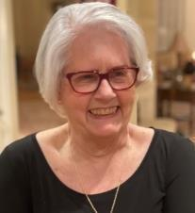
Kelvie Comer - AAUW Washington State Online President
Professional Highlights
Principal, Independent Non-Profit Organization Management Consultant
AAUW Washington State President (2012 - 2016), AAUW Nominating Committee, Chair. (2014-2015); also serve on AAUW-WA Tech Trek Committee, Professional Women's Night Chair, Corporate Fundraising
Dean of Education, Health, and Human Services; Central Michigan University
Interim Provost, Alma College, Michigan
Dean of the School of Professional Studies and Graduate School, Eastern Connecticut State University
Interim Dean, College of Fine and Applied Arts, The University of Akron, Ohio
Education
Temple University, Doctor of Education (Ed.D.), Master of Education (M.Ed.),
Penn State University, Bachelor’s Degree, Secondary Education, English/Language Arts Teacher Education
Kelvie C. Comer, Ed.D.
AAUW-Washington State Online Branch President
United States
21

Slide 22
Carolyn Hayek - AAUW WA Lake Washington Branch President
Carolyn Hayek is a Phi Beta Kappa graduate of Carleton College, Northfield, MN, with a BA Degree in Psychology. She earned a J.D. at the University of Chicago Law School and began her legal career with a business practice law firm in downtown Seattle.
After a few years, she established her own firm in Federal Way, where her practice emphasized family law, estate planning, and real estate, especially condominium law.
She left private practice in 1982 to accept an appointment by the King County Council to serve as a District Court Judge, a position she retained for 13 years, which included 3 election cycles, where she was uncontested. She eventually took early retirement to pursue other interests.
Within AAUW, she has served as president of four branches, including the WA Online Branch, where she was the founding president. She also served many years on the state board of AAUW, including 2 years as president. She has held leadership positions in the national AAUW organization as well.
Before becoming a judge, she ran unsuccessfully for city council and state representative. She had a limited budget and did no polling. That experience opened the door to various political appointments: city, county and state task forces and a state level commission.
Carolyn Hayek - AAUW- Lake Washington President

Slide 23
Dorothy McBride – Take Action!
Dorothy E McBride, professor emeritus of political science at Florida Atlantic University, earned her B.A. at University of Montana and an MA and PhD from Vanderbilt University.
In her career at FAU, she specialized in teaching and research in comparative politics and women and public policy and published several books and articles.
She also helped establish the M.A. in women’s studies program.
In 2005, she retired and moved to Tacoma, WA. After years of scholarly exploration of feminist influence in policy making in US and Western Europe, she turned to advocacy to challenge gender hierarchies and raise women’s status.
In AAUW, she found allies in this endeavor and now serves as public policy chair for the WA Online branch.
23

